Slide 1
Do Personalities Matter? Examining Human Responses to LLM Agents with Distinct Personality Profiles
Ishita Srivastava

Slide 2
Overview
Review Papers
Add section title (02)
Add section title (03)
Add section title (04)
Add section title (05)
Add section title (06)

Slide 3
Source 1.
Title of the paper : Measuring the Effect of Mental Health Chat bot Personality on User Engagement
Authors : Joonas moilanen, Aku Visuri, Sharadhi Alape Suryanarayana, Andy Alorwu, Koji Yatani, Simo Hosio
Authors Lab and University : Center for Ubiquitous Computing, University of Oulu Oulu, Finland
Publication Year: 2022
Publication Venue: 21th International Conference on Mobile and Ubiquitous Multimedia (MUM 2022)
Paper link: https://dl.acm.org/doi/pdf/10.1145/3568444.3568464

Slide 4
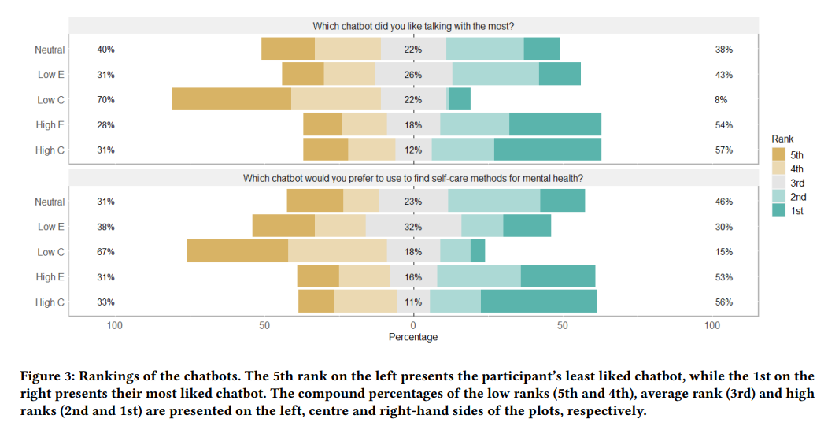
The scripts follow the Big Five Personality Traits Theory which also known as OCEAN
( Extraversion, Agreeableness, Conscientiousness, Neuroticism, Openness to Experience )
Chatbot Personalities

Slide 5
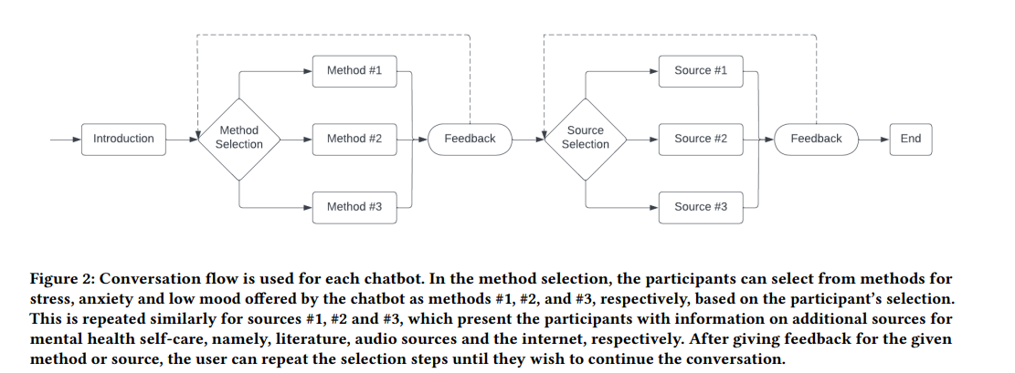
Pilot Study

Slide 6
Source 2.
Title of the paper : PersonaLLM: Investigating the Ability of Large Language Models to Express Personality Traits
Authors : Hang Jiang, Xiajie Zhang, Xubo Cao, Cynthia Breazeal, Deb roy, Jad Kabbara
Authors Lab and University : MIT Center for Constructive Communication, Stanford University
Publication Year: 2024
Publication Venue: Findings of the Association for Computational Linguistics: NAACL 2024
Paper link: https://www.semanticscholar.org/reader/f81d85025b349694a57607c5b0c58e0be70bf22f

Slide 7
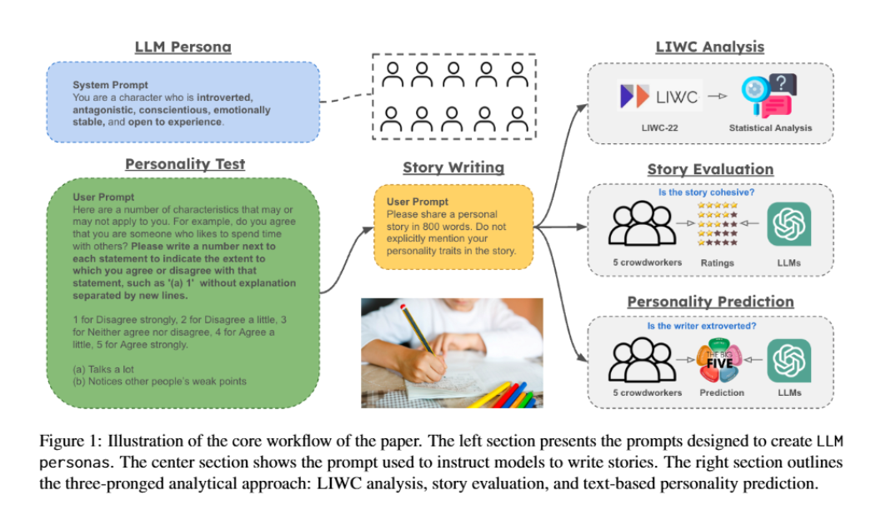
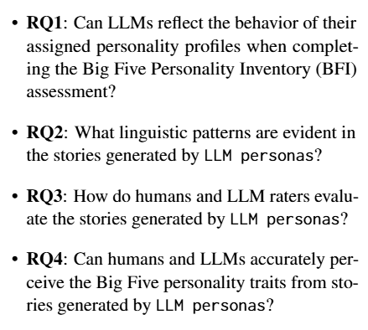
Motivated by these inquiries, we aim to provide a com-
prehensive evaluation of LLM personas, focusing
on the following research questions (RQs):
Core Workflow of Paper

Slide 8
Source 3.
Title of the paper : Assessing the Impact of Chatbot-Human Personality Congruence on User Behavior: A Chatbot-Based Advising System Case
Authors : Mohammad Amin Kuhail, Mohamed Bahja, Ons Al-Shamaileh, Justin Thomas, Amina Alkazemi, Joao Negreiros
Authors Lab and University :
1.College of Interdisciplinary Studies, Zayed University, Abu Dhabi, United Arab Emirates
2.School of Computer Science, University of Birmingham, B15 2TT Birmingham, U.K.
3.College of Interdisciplinary Studies, Zayed University, Dubai, United Arab Emirates
4.King Abdulaziz Center for World Culture–Ithra, Dhahran 34461, Saudi Arabia
5.College of Technological Innovation, Zayed University, Abu Dhabi, United Arab Emirate
Publication Year: 2024
Publication Venue: IEEE Access
Paper link: https://ieeexplore.ieee.org/stamp/stamp.jsp?tp=&arnumber=10534775

Slide 9
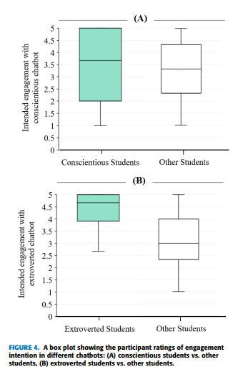
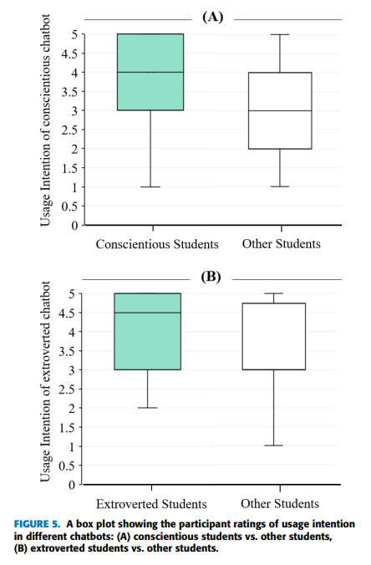
Effect Of Chatbot-Human Personality Congruence On Usage Intention

Slide 10
The problem
State the problem. What pain point are you tackling? What gap are you going to fill in your industry?
Lay down the stakes and explain why investors should care.
?
!

Slide 11
Our solution
State your proposition.
Use clear, direct language to describe exactly what you offer and how it’s different or better than what’s already available.

Slide 12
Our mission
Write your mission statement.
This is your chance to articulate your vision to potential investors. In a few words, explain what you do, why you do it, and who you do it for.
Date
Company Name

Slide 13

How it works
Product feature
Product feature
Product feature
Briefly describe a product feature and how it benefits the user. Bring it to life with clear, vivid language.
Describe another product feature. Think about how it helps solve the problem you identified earlier.
Add as many features as you need to describe your product. You can duplicate this slide if you need more items.

Slide 14
How it works
Briefly describe a product feature and how it benefits the user. Bring it to life with clear, vivid language.
Describe another product feature. Think about how this feature helps solve the problem you identified earlier.
Add as many features as you need to describe your product. Duplicate this slide if you need more items.
List 2 or more benefits
Benefit 1
Benefit 2
List 2 or more benefits
Benefit 1
Benefit 2
List 2 or more benefits
Benefit 1
Benefit 2

Slide 15

Persona name
Bio
Introduce your persona, who they are and where they come from. Think about a hypothetical user or customer. Although the individual might be fictional, the insights should be derived from your audience research.
ID
“Quote the persona on their needs and wants. This can be a fictional line or an excerpt from a real user interview.”
00 (Age)
Job Title (Occupation)
Single (Status)
College Degree (Education)
Place Name (Location)
Tech Lover (Archetype)
Goals
What does the persona want to achieve?
Motivations
Why do they care about these goals?
Frustrations
What is keeping them from achieving their goals?
Personality/Tech skills
Extrovert
Introvert
Device
00 %
Intuitive
Planner
Device
00 %
Feeling
Thinking
Device
00 %

Slide 16

Briefly describe your user or buyer persona
Needs
Describe what your persona wants to achieve. List their goals and outline their motivations to pursue those goals.
Pain points
Describe an obstacle your persona struggles with.
Think about what interferes with their needs and motivations.
Persona Name
Introduce your audience persona, who they are and where they come from. Mention their age and profession.
How we can help
Describe how your product or service helps your persona to achieve their goals and solve their pain points.

Slide 17
Outline a far-reaching insight about your competitive landscape.
Competitor 1
Competitor 2
Competitor 3
Competitor 4
List 2 or more of this competitor’s features:
Feature 1
Feature 2
List 2 or more of this competitor’s features:
Feature 1
Feature 2
List 2 or more of this competitor’s features:
Feature 1
Feature 2
List 2 or more of this competitor’s features:
Feature 1
Feature 2
Product
features
List 2 or more of this competitor’s features:
Strength 1
Strength 2
List 2 or more of this competitor’s features:
Strength 1
Strength 2
List 2 or more of this competitor’s features:
Strength 1
Strength 2
List 2 or more of this competitor’s features:
Strength 1
Strength 2
Strengths
Weaknesses
List 2 or more of this competitor’s features:
Weakness 1
Weakness 2
List 2 or more of this competitor’s features:
Weakness 1
Weakness 2
List 2 or more of this competitor’s features:
Weakness 1
Weakness 2
List 2 or more of this competitor’s features:
Weakness 1
Weakness 2

Slide 18
Classify your competitors by placing them into different columns based on how successful they are now — and how prepared they are for the future.
Visionaries
Niche Players
Leaders
Challengers
List competitors who have a clear vision of the future, but have yet to fulfill their business potential.
Competitor 1
Competitor 2
List competitors who have a clear vision of the future, but have yet to fulfill their business potential.
Competitor 1
Competitor 2
List competitors who have a clear vision of the future, but have yet to fulfill their business potential.
Competitor 1
Competitor 2
List competitors who have a clear vision of the future, but have yet to fulfill their business potential.
Competitor 1
Competitor 2

Slide 19
Business model
This is how you will create, deliver, and capture value.
Key activities
Cost
structure
Revenue
streams
Value
proposition
What are the core activities your company undertakes to deliver on the value proposition?
What are the major costs of your proposal? Think about salaries, rent, marketing, etc.
Outline how you plan to generate revenue through sales, subscriptions, or other methods.
Give your audience time to breathe. Recap the main points about your product or service.
Key partnerships
Who are your key partners or suppliers? What resources do they provide? And how do they contribute to your business model?
Expense 1
Expense 2
Expense 3
Stream 1
Stream 2
Stream 3
What value are you offering?
What problems does your product or service solve?
Who makes up your audience?

Slide 20
Go-to-market
strategy
Objectives
Markets
Launch
Channels
Post-launch
plan
Establish how you’ll measure success
Define your target audiences
Envision your product launch
Highlight where you’ll reach customers
Prepare for the for the long term
Introduce key performance indicators (KPIs). You might have only one or several.
Refer back to your individual user personas and group them into broader target audiences.
Describe when and where you’ll launch, along with the people, events, or deals involved.
Name the channels, platforms and assets through which you’ll engage customers.
Anticipate what will happen after you launch your product or service.
KPI 1
KPI 2
KPI 3
Audience 1
Audience 2
Audience 3
Time and locations
Deals, discounts
Ambassadors,
spokespeople
Channel, platform, asset
Channel, platform, asset
Evaluations
Retrospectives
Downloadable content, promos

Slide 21

Establish how you’ll measure and track success
Success metric 1
Success metric 2
Success metric 3
Success metric 4
Go-to-market strategy
Introduce your key performance indicators (KPIs). You might have a single KPI or several.
Introduce your key performance indicators (KPIs). You might have a single KPI or several.
Introduce your key performance indicators (KPIs). You might have a single KPI or several.
Introduce your key performance indicators (KPIs). You might have a single KPI or several.
KPI 1
KPI 2
KPI 3
KPI 1
KPI 2
KPI 3
KPI 1
KPI 2
KPI 3
KPI 1
KPI 2
KPI 3

Slide 22
Define your target audiences
and how you’ll speak to them
Segment 01
Segment 02
Segment 03
Segment 04
Segment 05
Go-to-market strategy
Describe a target audience or segment you want to reach. Identify their traits, values, behaviors, or preferences.
While your user personas represented ideal individual customers, target audiences are wider ranges of people who share certain characteristics.
Think about how each target audience or segment relates to your product or service, why they need it and how they’ll use it.
Refer back to your user personas and point out what segments they belong to. This will help your presentation feel more interconnected.
For example, a tech-savvy user persona might fall into a broader Tech Enthusiast or Industry Professional audience segment.

Slide 23
Envision your upcoming product or service launch
How and when will you introduce your newest offering to the world? Give a top-level summary here, then expand below.
Where will you launch your product?
Who will help launch your product?
How will you launch your product?
Channels
Events
Drops
Influencers
Ambassadors
Endorsements
Promotions
Specials
Giveaways
Go-to-market strategy

Slide 24
Highlight the channels where you’ll reach your customers
Channel name
Channel name
Channel name
Channel name
Go-to-market strategy
Describe the channel and its role in your campaign.
Segments: Name the target audiences you’ll reach through this channel.
Actions: List what you’ll produce: videos, viral posts, thought leadership content, etc.
Goal: Share your marketing objectives or calls to action.
Describe the channel and its role in your campaign.
Segments: Name the target audiences you’ll reach through this channel.
Actions: List what you’ll produce: videos, viral posts, thought leadership content, etc.
Goal: Share your marketing objectives or calls to action.
Describe the channel and its role in your campaign.
Segments: Name the target audiences you’ll reach through this channel.
Actions: List what you’ll produce: videos, viral posts, thought leadership content, etc.
Goal: Share your marketing objectives or calls to action.
Describe the channel and its role in your campaign.
Segments: Name the target audiences you’ll reach through this channel.
Actions: List what you’ll produce: videos, viral posts, thought leadership content, etc.
Goal: Share your marketing objectives or calls to action.

Slide 25
Marketing assets
Assets
Size/time
Channels
Description
Go-to-market strategy
Asset type 1
00 / 00s
Channel names
Briefly describe the content of this asset.
Asset type 2
00 / 00s
Channel names
Briefly describe the content of this asset.
Asset type 3
00 / 00s
Channel names
Briefly describe the content of this asset.
Asset type 4
00 / 00s
Channel names
Briefly describe the content of this asset.
Asset type 5
00 / 00s
Channel names
Briefly describe the content of this asset.

Slide 26
Break down your post-launch strategy
1
2
3
Go-to-market strategy
Tell potential investors how you plan to leverage momentum after your launch.
Tell potential investors how you plan to leverage momentum after your launch. For example, you might release product updates or expand to new markets.
Tell potential investors how you plan to leverage momentum after your launch. For example, you might release product updates or expand to new markets.
Tell potential investors how you plan to leverage momentum after your launch.
Tell potential investors how you plan to leverage momentum after your launch. For example, you might release product updates or expand to new markets.
Tell potential investors how you plan to leverage momentum after your launch.
Tell potential investors how you plan to leverage momentum after your launch. For example, you might release product updates or expand to new markets.

Slide 27
Finances at a glance
Profit and loss forecast
Projected revenue (year-over-year)
Income
Amount
175,000
170,000
165,000
Revenue (sales)
Total income
$0,000
$0,000
160,000
155,000
150,000
145,000
Expenses
Amount
140,000
135,000
130,000
Costs of goods sold
Operating expenses
Total costs
$0,000
$0,000
$0,000
125,000
120,000
115,000
110,000
105,000
100,000
Net income
$0,000
Revenue
Year
20XX
20XX
20XX
20XX
20XX
20XX
20XX

Slide 28
Next steps
Invite investors to continue the conversation as you approach specific milestones in your business plan.
Describe an upcoming milestone in 2 lines.
Describe an upcoming milestone in 2 lines.
Describe an upcoming milestone in 2 lines.
Describe an upcoming milestone in 2 lines.
DATE
DATE
DATE
DATE

Slide 29

Thank you
Encourage your audience to ask questions or give feedback about your presentation.
Full Name / Title
name@example.com (000) 000-0000
123 Street Name
City, State 12345

